Slide 1
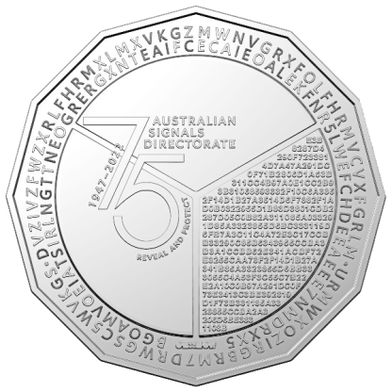
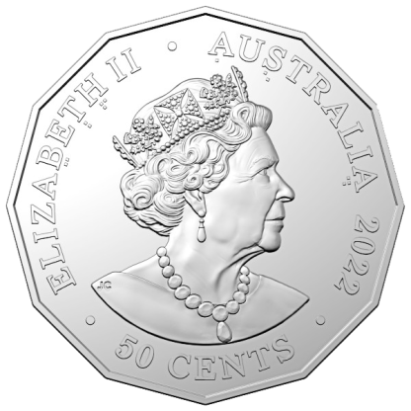
75th Anniversary Commemorative Coin
Craeft & DigiPat

Slide 2

First, what is the: Australian Signals Directorate
ASD's purpose is to defend Australia from global threats and help advance Australia's national interests. We do this by mastering technology to inform, protect and disrupt.
Informing
Collecting covert foreign intelligence (signals intelligence) to provide critical insights.
Protecting
Understanding and mitigating cyber threats.
Providing proactive advice to government, businesses, and the community to enhance cybersecurity resilience.
Disrupting
Deploying offensive cyber capabilities offshore.
Supporting military operations, counter-terrorism, and counter-cyber espionage.
Combating serious cyber-enabled crime.
ASD operates in the slim space between the difficult and the impossible.

Slide 3
What is the history: Australian Signals Directorate
The History of ASD continues:
1942 – World War II
Australian Navy, Army, and Air Force personnel united to support General MacArthur’s South-West Pacific campaign.
Mission: Intercept and decode Japanese radio signals to gain intelligence advantage.
23 July 1946
Formal establishment of Australia’s signals intelligence capability.
01 April 1947 – Defense Signals Bureau (DSB)
Founded in Melbourne.
Tasked with:
Foreign communications exploitation (signals intelligence).
Communications security for the armed forces and government.
This foundation evolved into today’s Australian Signals Directorate (ASD), a leader in intelligence and cybersecurity.

Slide 4
What is the history: Australian Signals Directorate
The History of ASD continues:
October 1949 – Defence Signals Branch
Renamed from the Defence Signals Bureau.
January 1964 – Defence Signals Division
Expanded role in signals intelligence and security.
1977 – Formal Recognition
The Hope Royal Commission into Intelligence and Security acknowledged DSD’s intelligence role.
Announced in the Prime Minister’s statement to the House of Representatives.
Each transformation strengthened ASD’s mission in intelligence, cybersecurity, and national defense

Slide 5
What is the history: Australian Signals Directorate
The History of ASD continues:
1979 – A Permanent Home
Relocated from its ‘temporary’ accommodation in Albert Park to a purpose-built facility at Victoria Barracks, Melbourne.
1986 – Supercomputing Era Begins
Acquired Australia’s first supercomputer, a Cray Research system, enhancing intelligence capabilities.
June 1988 – Move to Canberra
Government decided DSD should relocate to Defence headquarters at Russell Offices, Canberra.
Enabled closer collaboration with Defence, intelligence agencies, and key government departments.
These milestones strengthened DSD’s technological capabilities and strategic partnerships.

Slide 6
What is the history: Australian Signals Directorate
The History of ASD continues:
The 2000s – Rise of Information Security
Rapid internet expansion and online service adoption by Australian governments.
Increased focus on protecting national digital infrastructure.
January 2010 – Cyber Security Operations Centre (CSOC)
Established to monitor and respond to ICT security threats.
Developed a comprehensive understanding of cyber threats to Australia’s critical systems.
Coordinated cyber defense efforts across government and industry.
ASD’s Modern Evolution marked their transformation into a leader in national cybersecurity.

Slide 7
What is the history: Australian Signals Directorate
The History of ASD continues:
May 2013 – A New Identity
Defence Signals Directorate (DSD) renamed Australian Signals Directorate (ASD).
Reflects its whole-of-government role in national security.
November 2014 – Strengthening Cybersecurity
Cyber Security Operations Centre (CSOC) evolved into the Australian Cyber Security Centre (ACSC).
Marked a new phase in Australia’s cyber defense capabilities.
July 2017 – Intelligence Review
Prime Minister released the unclassified version of the 2017 Independent Intelligence Review.
These milestones reinforced ASD’s leadership in intelligence and cybersecurity.

Slide 8
What is the history: Australian Signals Directorate
The History of ASD continues:
April 2018 – ASD Becomes a Statutory Agency
The Intelligence Services Amendment (Establishment of ASD) Bill 2018 received Royal Assent and became law on 11 April 2018.
On 1 July 2018, ASD officially became a statutory agency within the Defence portfolio.
December 2019 – Historic Leadership Appointment
Prime Minister announced Ms. Rachel Noble PSM as Director-General Designate of ASD.
In January 2020, she became the first woman to lead ASD.
A New Era of Independence & Leadership, these milestones strengthened ASD’s independence and leadership in national security.

Slide 9
What is the Commemorative Coin: Australian Signals Directorate
1 September 2022 - the Royal Australian Mint released a limited edition 50 cent commemorative coin to celebrate the Australian Signals Directorate's (ASD) 75th anniversary. Fifty thousand coins have been produced..

Slide 10

Challenge Accepted: ASD Commemorative Coin
Let’s
Gets Started

Slide 11
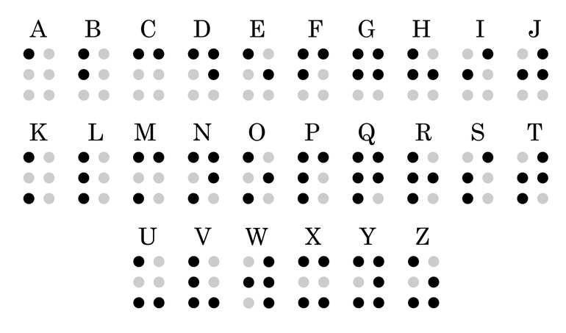
Where to start: ASD Commemorative Coin
On the front of the coin we noticed that there is what appears to be Braille under certain letters.

Slide 12


Where to start: ASD Commemorative Coin
Here we see the Braille letters. Along the bottom row is their Latin transcription, and the top row is their associated letters.

Slide 13
Where to start: ASD Commemorative Coin
Using the Braille letters from 'C B F A E D' as reference points for positioning.
We are rearranging the letters on the coin to align with the positions of 'A B C D E F'.
The original letters on the coin give us "ATBASH".

Slide 14
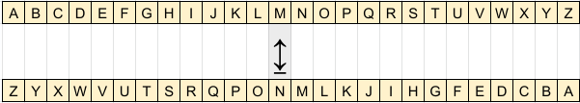
Where to start: ASD Commemorative Coin
Definition: The ATBASH cipher is a substitution cipher that uses a single key to reverse all the letters, with A mapped to Z, B to Y, C to X, and so on. Originally used to encode the Hebrew alphabet, it can be adapted to encode any alphabet.

Slide 15
Where to start: ASD Commemorative Coin
We guessed that the letters on the back outside ring are encrypted using the ATBASH Cipher.
Time to write a little Python3.

Slide 16
Where to start: ASD Commemorative Coin
Using our ATBASH routines we were able to decipher the outer ring. The output shows us how to decipher the inner ring of characters.
#!/usr/bin/python3
import sys
# Getting command line Encoded data.
if len(sys.argv) < 2:
print("SYNTAX: ATBASH <Encoded Text>");exit()
Encode = sys.argv[1]
KEYS = "ABCDEFGHIJKLMNOPQRSTUVWXYZ"
ATBASH = KEYS [::-1]
Decode = ""
for Char in Encode:
pos = ATBASH.find(Char.upper())
if pos == -1: Decode += Char
else: Decode += KEYS[pos]
print(Decode)
→ ATBASH.ph "DVZIVZFWZXRLFHRMXLMXVKGZMWNVGRXFOLFHRMVCVXFGRLM"
WEAREAUDACIOUSINCONCEPTANDMETICULOUSINEXECUTION
ENC: DV ZIV ZFWZXRLFH RM XLMXVKG ZMW NVGRXFOLFH RM VCVXFGRLM
DEC: WE ARE AUDACIOUS IN CONCEPT AND METICULOUS IN EXECUTION
→ ATBASH.ph "URMWXOZIRGBRM7DRWGSC5WVKGS"
FINDCLARITYIN7WIDTHX5DEPTH
ENC: URMW XOZIRGB RM 7 DRWGS C 5 WVKGS
DEC: FIND CLARITY IN 7 WIDTH X 5 DEPTH

Slide 17


Where to start: ASD Commemorative Coin
We assumed the inner ring used a transposition cipher. We arranged the characters in a 7 across by 5 down grid. That we got from the last puzzel, and then read the message by columns instead of rows.
7 x 5 Squares
BGOAMVO ECAIEOA
EIATSIR LEKFNR5
LNGTTNE LWEFCHD
OGRERGX EEAEEE7
NTEAIFC NMDRXX5
→ ANSWER
BELONGING TO A GREAT TEAM STRIVING FOR EXCELLENCE WE MAKE A
DIFFERENCE XOR HEX A5D75

Slide 18
Where to start: ASD Commemorative Coin
What does XOR HEX A5D75 give us?
We hypothesized that this was the XOR Mask used to encrypt the hexadecimal sequence on the reverse of the coin. An XOR Mask works by repeating the mask to match the length of the message, then XOR'ing the sequence with the message to generate the ciphertext.
In this case, we take A5D75 and concatenate it with itself to produce A5D75A5D75A5D75...
The result of the XOR operation yields an ASCII value, which corresponds to the character in the hidden message.
Let’s explore how this process works.

Slide 19
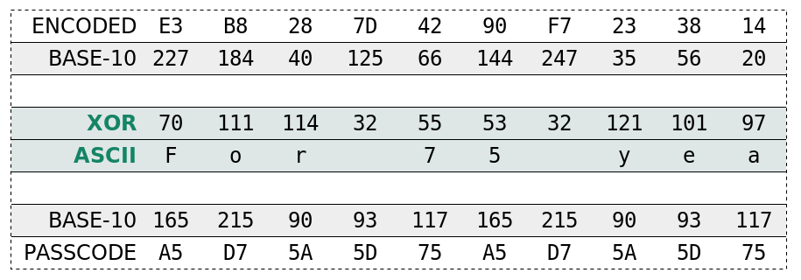
Where to start: ASD Commemorative Coin
Below is a partial breakdown of how the code works, deciphering the hidden message by processing every two hexadecimal bytes.
#!/usr/bin/python3
s="""E3B8287D4290F7233814D7A47A291DC0F71B2806D1A53B311CC4B97A0E1CC2
B93B31068593332F10C6A3352F14D1B27A3514D6F7382F1AD0B0322955D1B83D380
1CDB2287D05C0B82A311085A033291D85A3323855D6BC333119D6FB7A3C11C4A72E
3C17CCBB33290C85B6343955CCBA3B3A1CCBB62E341ACBF72E3255CAA73F2F14D1B
27A341B85A3323855D6BB333055C4A53F3C55C7B22E2A10C0B97A291DC0F73E3413
C3BE392819D1F73B331185A3323855CCBA2A3206D6BE3831108B""".replace("\n
", "")
# Break S into HEX pairs.
n = 2
pairs = [s[i:i+n] for i in range(0,len(s), n)]
# Expanding the "A5D75" to the length of S and Breaking into HEX pairs
k = "a5d75"
kr = k*int((1+len(s)/len(k)))
kp = [kr[i:i+n] for i in range(0,len(kr), n)]
# Converting Seperate HEX pairs to Integers and XOR the output
msg = '';
for i in range(len(pairs)):
a = int(pairs[i],16) ^ int(kp[i],16)
# Converting Integer to ASCII and Appending it to the message
msg = msg + chr(a)
print(msg)
→ HEX_XOR.ph
For 75 years the Australian Signals Directorate has brought
together people with the skills, adaptability and
imagination to operate in the slim area between the
difficult and the impossible.

Slide 20
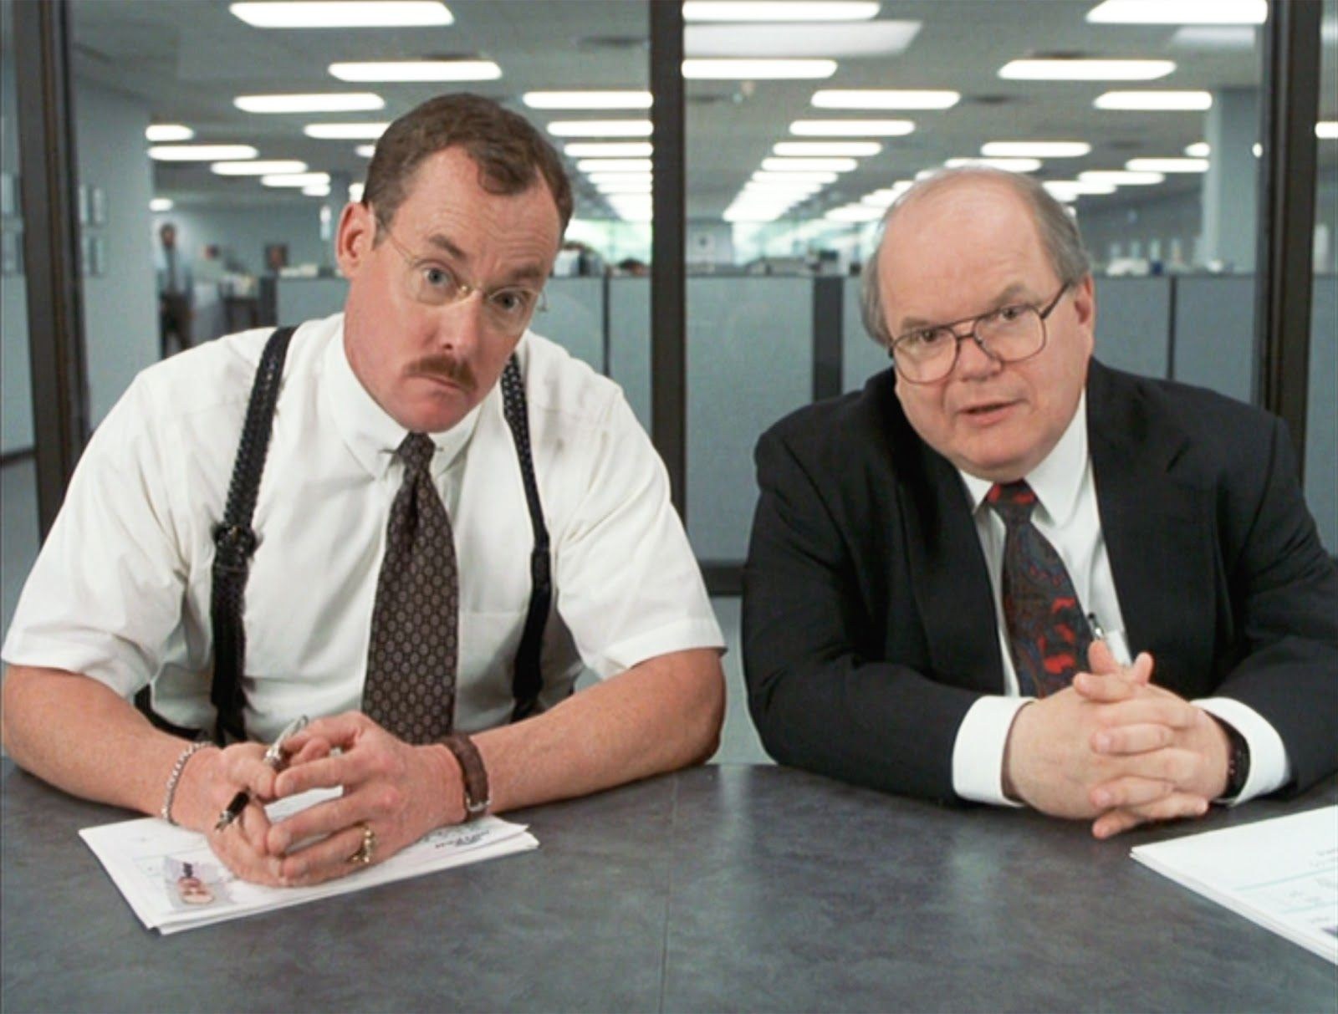
Solved: ASD Commemorative Coin
We were thrilled to have solved the four ciphers on the coin.
But, there must be more to solve!
And you're right—there are two more bonus challenges. Let’s get started!

Slide 21
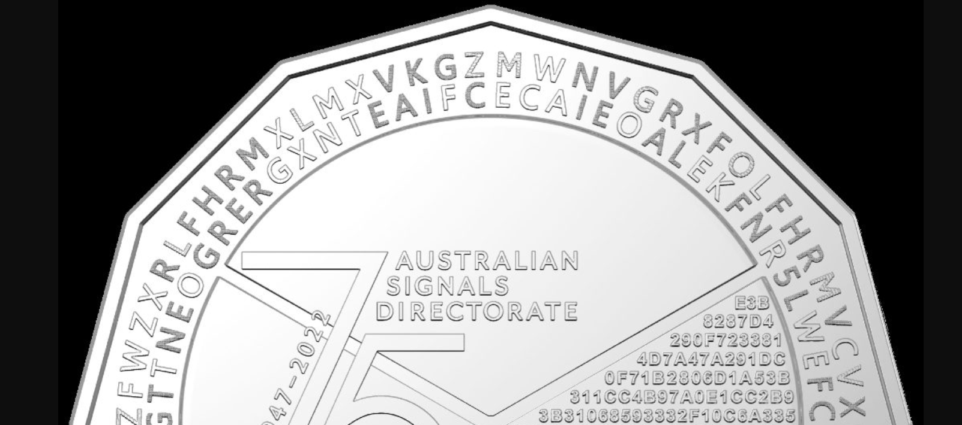
Bonus Round: ASD Commemorative Coin
Upon examining the inner and outer rings, you noticed some had different colors and odd shading. Let's start by focusing on the inner ring.

Slide 22
Bonus Round 1: ASD Commemorative Coin
The inner ring features two colors, light and dark fonts. We can assume this represents Base 2, or Binary. Let’s explore the conversion.

Slide 23
Bonus Round 1: ASD Commemorative Coin
The light characters are converted to 1s, and the dark characters to 0s. There are 70 letters, which convert to 10 7-bit words. We can then translate these words into 10 ASCII characters.
The answer is ASD (Australian Signals Directorate), CBD (Canberra), 2022.
#!/usr/bin/python3
bits = "10000011010011100010010000111100010"
bits += "11100100110010011000001100100110010"
print("Number of Bits: ",len(bits))
# Break Bits into 7-Bit bytes pairs.
numBits = 7
pairs = [bits[i:i+numBits] for i in range(0,len(bits), numBits)]
print(pairs)
# Converting Seperate HEX pairs to Integers
# and XOR the output
msg = '';
for i in range(len(pairs)):
a = int(pairs[i],2)
# Converting Integer to ASCII and Appending
# it to the message
msg = msg + chr(a).upper()
print(msg)
→ 7BIT_ASCII.ph
Number of Bits: 70
['1000001', '1010011', '1000100', '1000011', '1100010',
'1110010', '0110010', '0110000', '0110010', '0110010']
ASDCBR2022
Answer: ASD CBR 2022

Slide 24
Bonus Round 2: ASD Commemorative Coin
The outer ring features three colors: light, dark, and a textured font. After trying various approaches, we determined this represented Morse Code.

Slide 25
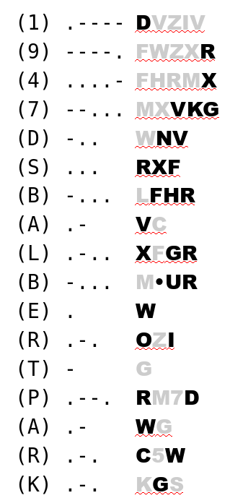
Bonus Round 2: ASD Commemorative Coin
We convert the dark character to a dot, the light character to a dash, and the textured font to a space.
Once the letters are converted into dots, dashes, and spaces, we can translate the Morse Code into letters and numbers.
The result is 1947 DSB (Defence Signals Bureau) Albert Park.
→ ANSWER
1947 DSB ALBERT PARK

Slide 26
Challenge Accepted: ASD Commemorative Coin
Any Questions?

Slide 27
From: asd.commemorativecoin Date: Tue, Nov 1, 2022 at 10:08 PM Subject: ASD's 75th Anniversary Commemorative Coin Challenge
Hello,
Congratulations on solving ASD’s 75th commemorative coin challenge! You were among the few who tried and successfully revealed the codes. That is truly impressive.
We hope you had as much fun cracking the codes and deciphering the messages, as we did in creating them. The type of skills you’ve used to solve these puzzles are exactly what ASD staff use on a daily basis.
We are delighted that you took the time to participate in our coin challenge. Keep visiting our website to find out more about ASD, or follow us at @insta @linkedin @twitter.
We really enjoyed creating our 75th commemorative coin. Thank you for taking part.
The ASD team.
IMPORTANT: This email remains the property of the Department of Defence. Unauthorised communication and dealing with the information in the email may be a serious criminal offence. If you have received this email in error, you are requested to contact the sender and delete the email immediately.
Any Questions?

Slide 28
Challenge Accepted: ASD Commemorative Coin
Thanks Again,
Australian Signals Directorate

